Slide 1
Pizza Sales
Simple Business Theme and Insights
Simple Business Theme and Insights

Slide 2

Introduction
This presentation focuses on the analysis of pizza sales and customer behavior within a simple business framework. Key insights include sales performance metrics, customer segmentation, and revenue patterns, aiding strategic decision-making for growth and enhanced customer engagement.

Slide 3
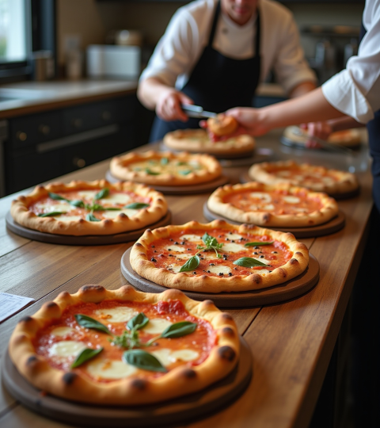
01
Pizza Sales Analysis

Slide 4




Business Performance Overview and Key Metrics
The pizza sales business has been evaluated based on total units sold, revenue generated, and growth trends. Key metrics indicate which product categories and pizza sizes contribute most to sales. Understanding these factors helps in optimizing inventory, pricing strategies, and identifying peak sales periods for better revenue management.

Slide 5
Revenue Distribution by Customer Segments
Revenue insights reveal how different customer segments contribute to overall sales. Loyal customers and high-value segments are identified, showing potential areas for targeted marketing. Analyzing customer preferences and purchase patterns facilitates personalized offers, ensuring stronger customer retention and increased average spending.

Slide 6
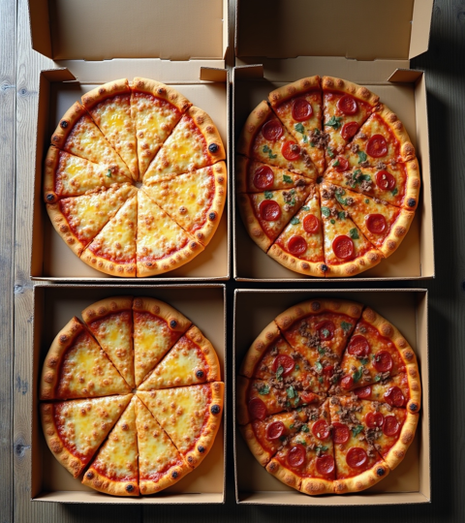
Product Category and Size Performance Insights
Classic pizzas lead revenue, with chicken-based varieties dominating the top-sellers. Revenue is well balanced across categories, suggesting a diverse customer palate. Large and medium pizza sizes generate about 76% of total revenue, while XL and XXL sizes contribute less than 2%. Focus on promoting Large and Medium sizes alongside flagship products for maximum impact.

Slide 7
01
Customer Behavior and Strategic Recommendations

Slide 8
Loyalty, Repeat Buyer Trends, and Subscription Opportunities
A significant number of repeat buyers are not subscribed yet, representing an untapped business opportunity. Loyal customers number 3,116 and generate substantial revenue. Encouraging subscription through loyalty-based tiers and milestone incentives can convert these repeat buyers into stable, predictable revenue streams.

Slide 9
Promotional Impact and Discount Strategies
High-value customers maintain strong spending even with discounts, but promotions heavily influence some product sales. Recommend targeted discounts for high-value customers to maximize profit while avoiding blanket promotions that erode margins. This balanced approach supports customer retention and profitability.

Slide 10
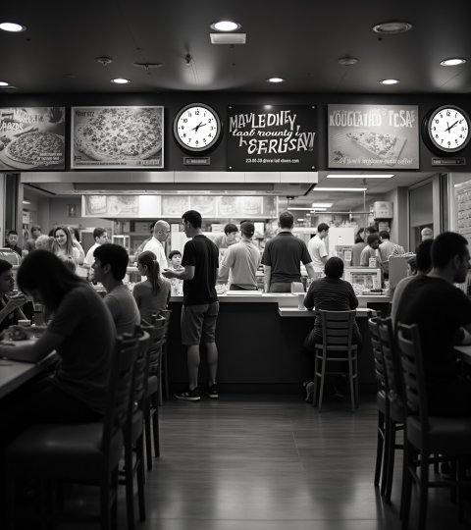
Sales Timing, Operational Adjustments, and Growth Initiatives
Sales peak during 12–3 PM and 6–9 PM, especially on Fridays and Saturdays. Operational strategies should include increased staffing during these hours and weekend family combo promotions to leverage peak demand. Growth initiatives focus on upselling Large sizes and bundling top-selling Classic and Chicken pizzas in marketing campaigns.

Slide 11
Conclusions
The pizza business shows strong customer loyalty and balanced revenue spread across key product categories. Targeted promotions and subscription conversions represent powerful growth opportunities. Optimizing inventory toward Large and Medium sizes and personalized marketing strategies will drive higher profitability and sustained business expansion.

Slide 12
Thank you
Project’s name
Do you have any questions?
youremail@freepik.com
+00 000 000 000
yourwebsite.com
Please keep this slide for attribution

